Slide 1
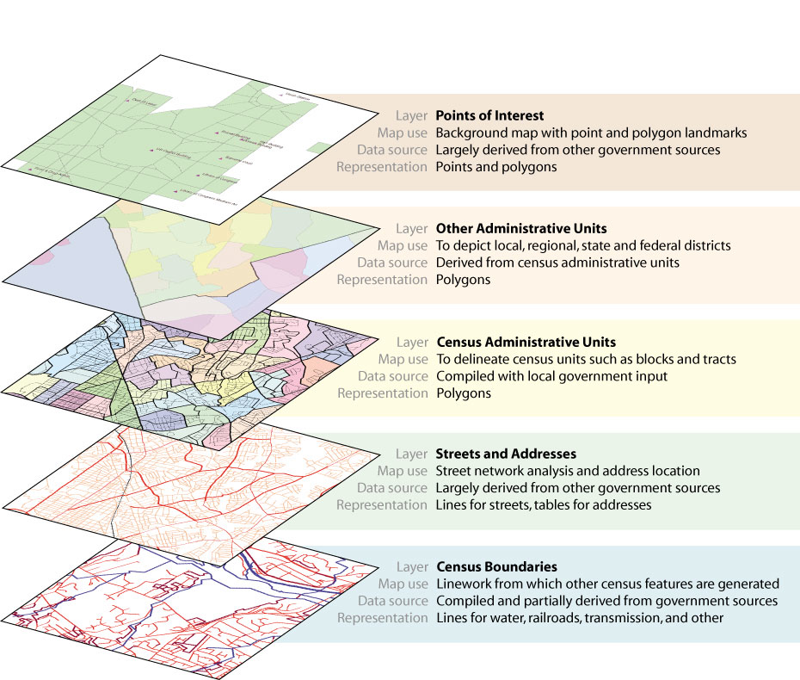
For the flip book
http://www.esri.com/news/arcnews/summer03articles/summer03gifs/p29p1-lg.jpg

Slide 2
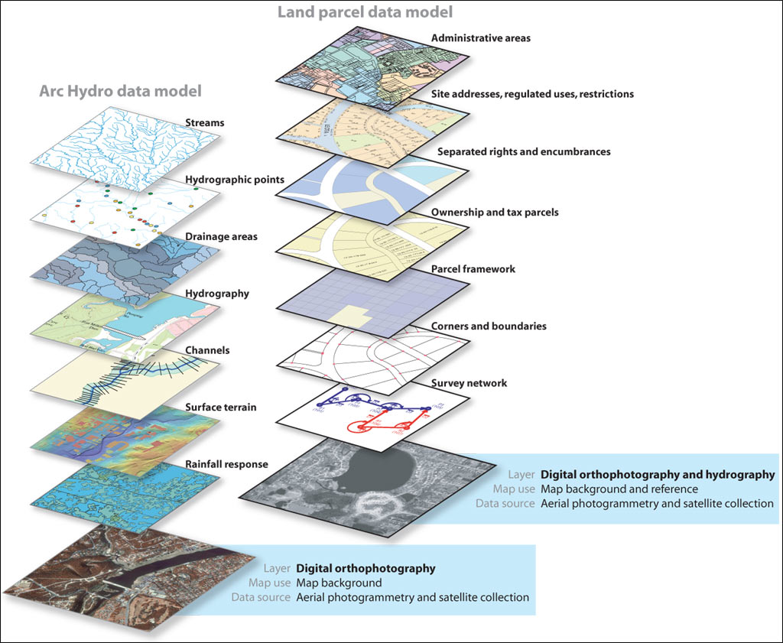
Create just the
Land parcel data
Model as a flip book
http://www.esri.com/news/arcnews/fall04articles/arcgis-raster-data-model.html
Notes:
Tools of visualizing place
Node-any point on a geographic surface
Arc-a line connecting two nodes (street, political boundary)
Polygon -a shape made out of arcs (ZIP, county, state, country)

Slide 3
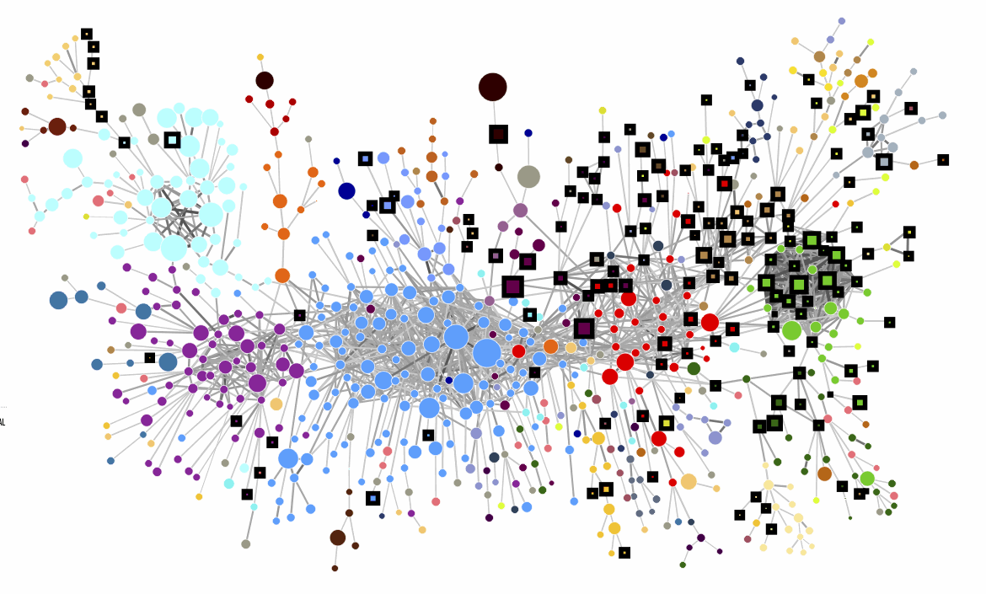
Picture of the guatemalan economy
http://www.businessinsider.com/atlas-of-economic-complexity-2011-10?op=1
Notes:
Live in world of increasing complexity guatemala
mirot

